Slide 1
ICS2-homwork5

Slide 2
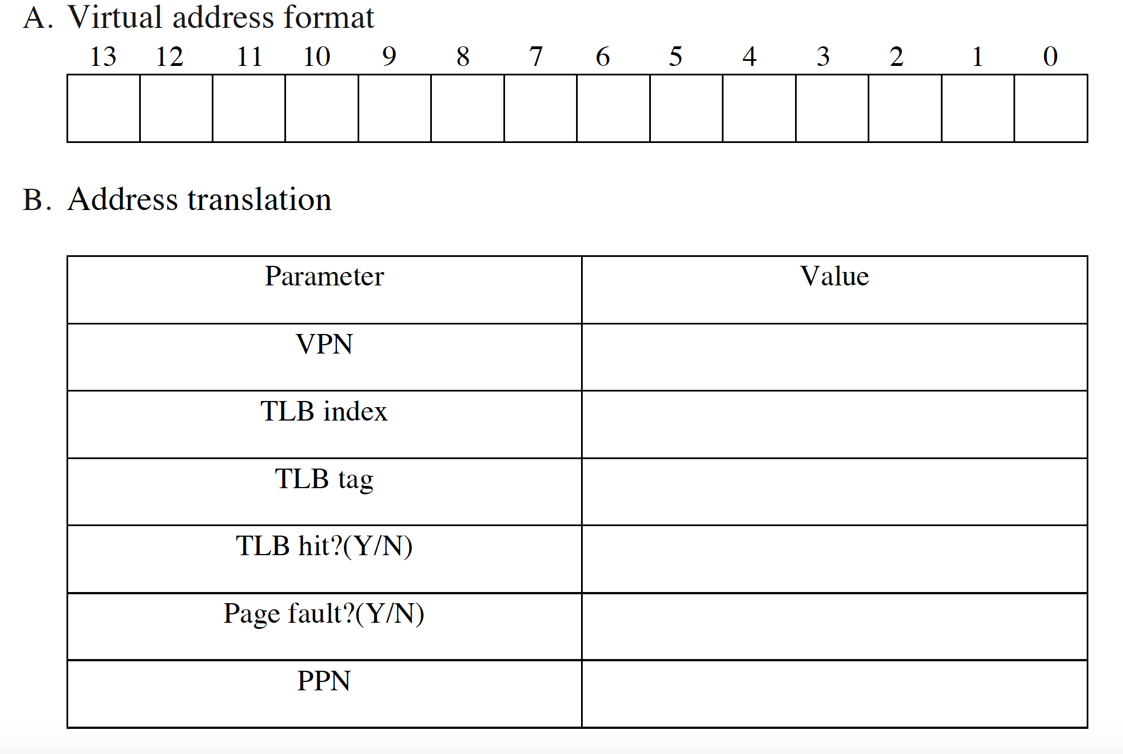
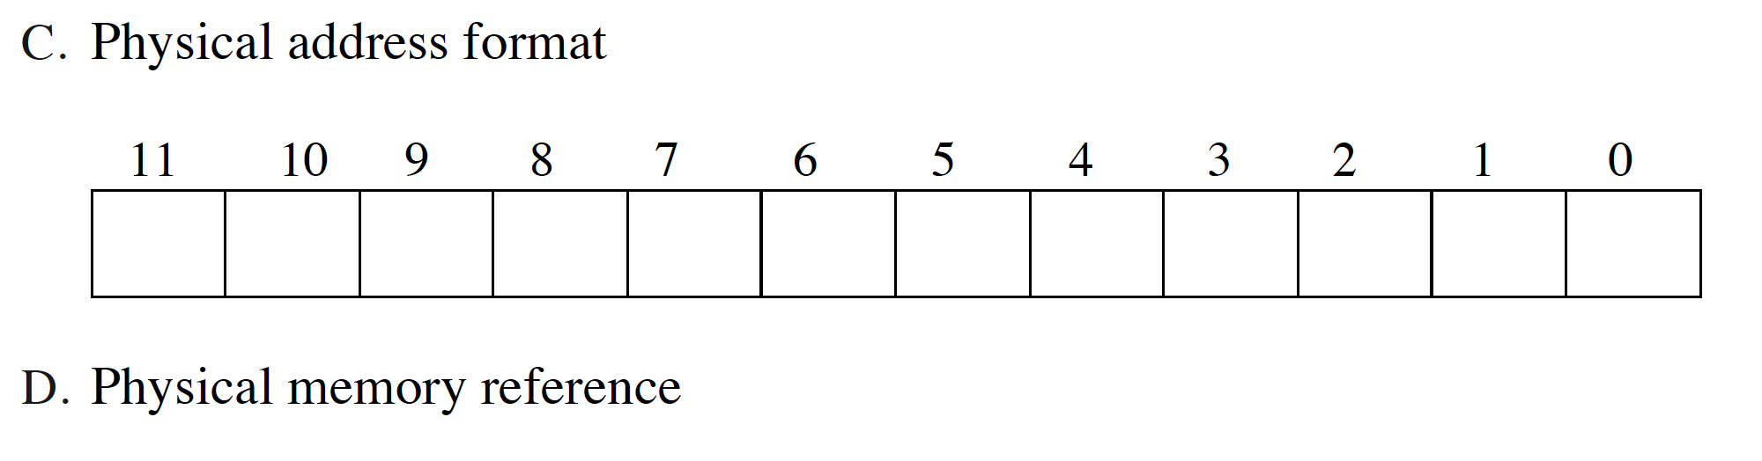
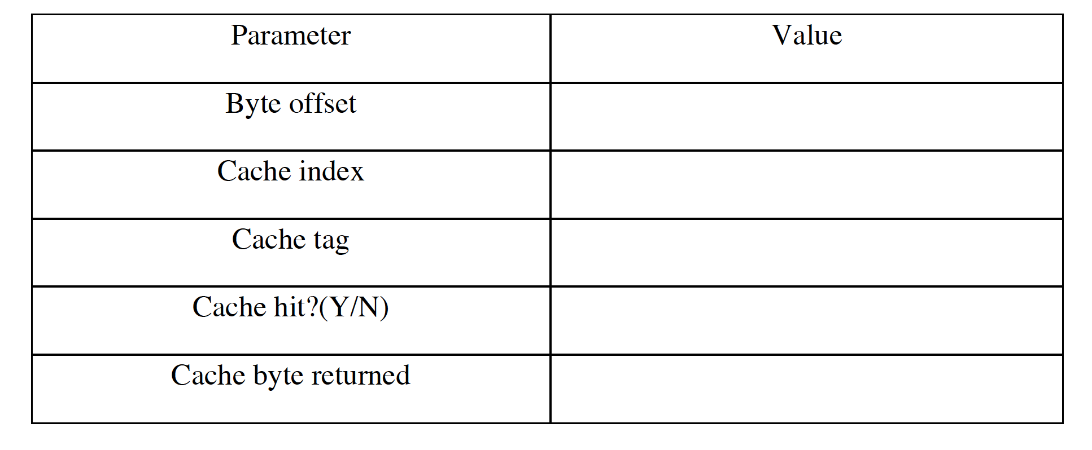
问题1
根据9.6.4的示例内存程序，给定virtual address 0x03FC，完成下列表格

Slide 3
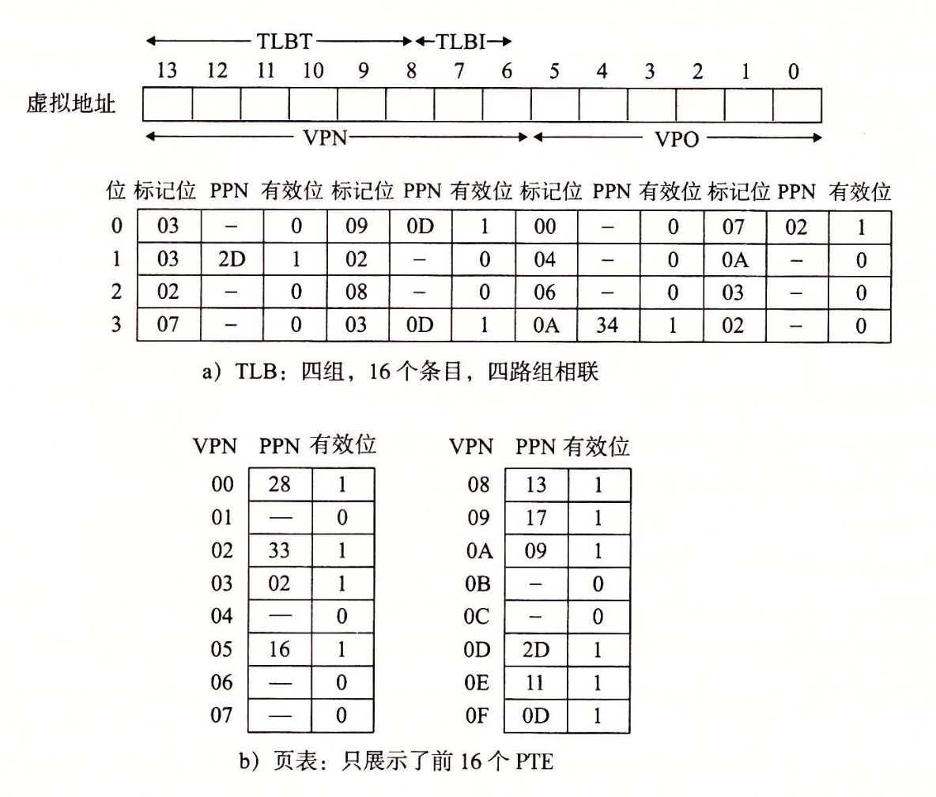
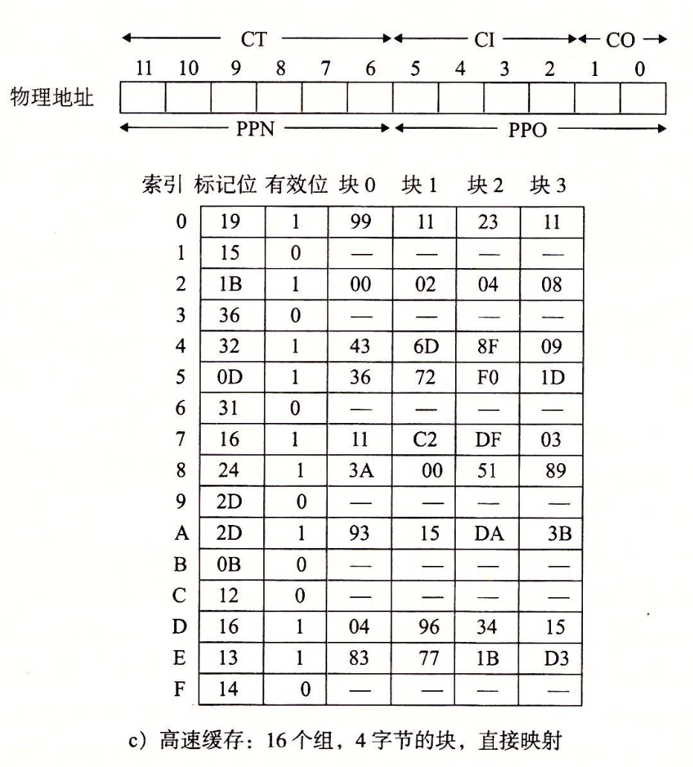

Slide 4
问题2
计算机有64位虚拟地址空间，page size是2048B，page table entry长度是4B。用multi-level page table把所有页面放在表中，需要多少levels？写出解题步骤。注意页表本身也是以page为单位进行空间分配和管理的，其中第一级页表是一个完整的page。

Slide 5
问题3
一个计算机虚拟内存空间大小为1MB，物理内存空间大小为8MB。虚存空间依次分为4个segment（code, data, heap, stack），采用segmentation内存管理，用Va最高两位标记segment，有寄存器记录下列信息。请根据给定程序回答问题。
segment | base | size | positive
code | 4MB | 4KB | 1
data | 2MB | 2KB | 1
heap | 7MB | 8KB | 1
stack | 1MB | 256KB | 0

Slide 6
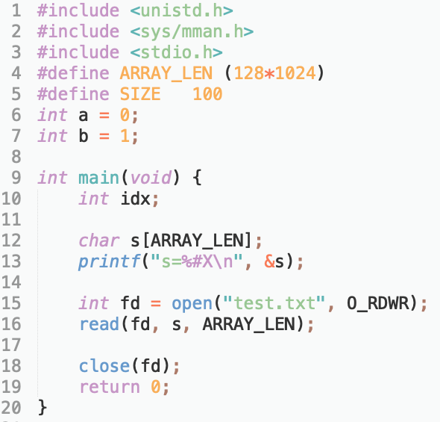
问题3
程序涉及到的数据结构被存放在了哪一段？请画图标注。
程序输出了s=0xC1300，求s对应的PA。如果VA=258K/514K，对应的PA是多少？写出求解过程。

Slide 7
问题4
The following problem concerns virtual memory and the way virtual addresses are translated into physical addresses. Below are the specifications of the system on which the translation occurs.
The system is a 16-bit machine - words are 2 bytes.
Memory is byte addressable.
The maximum size of a virtual address space is 64KB.
The system is configured with 16KB of physical memory.
The page size is 64 bytes.
The system uses a two-level page tables. Tables at both levels are 64 bytes (1 page) and entries in both tables are 2 bytes as shown below.

Slide 8
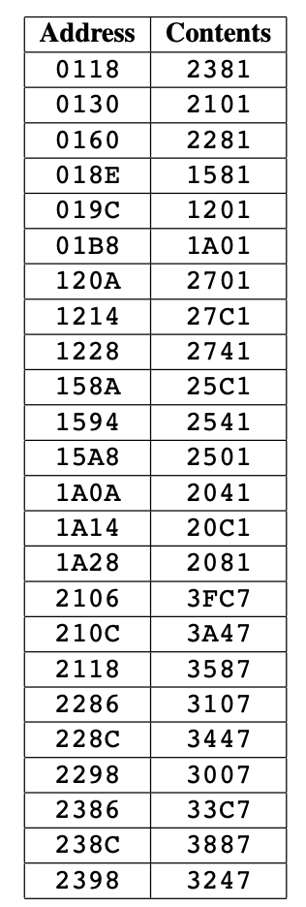
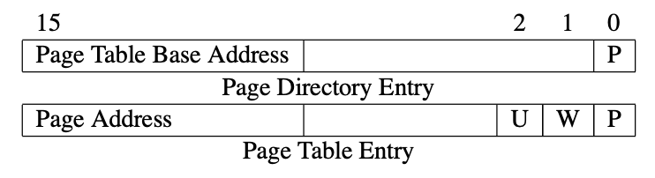
问题4
In this problem, you are given parts of a memory dump of this system running 2 processes. In each part of this question, one of the processes will issue a single memory operation (read or write of one byte) to a single virtual address (as indicated in each part). Your job is to figure out which physical addresses are accessed by the process if any, or determine if an error is encountered.
Entries in the first and second level tables have in their low-order bits flags denoting various access permissions.
• P=1⇒Present • W = 1 ⇒ Writable (applies both in kernel and user mode)
• U = 1 ⇒ User-mode
The contents of relevant sections of memory is shown on the next page. All numbers are given in hexadecimal.
For the purposes of this problem, omitted entries have contents = 0.

Slide 9
问题4
Process 1 is a process in user mode (e.g. executing part of main()) and has page directory base address 0x0100. Process 2 is a process in kernel mode (e.g. executing a read() system call) and has page directory base address 0x0180.
For each of the following memory accesses, first calculate and fill in the address of the page directory entry and the page table entry. Then, if the lookup is successful, give the physical address accessed. Otherwise, circle the reason for the failure and give the address of the table entry causing the failure. You may use the 16-bit breakdown table if you wish, but you are not required to fill it in.

Slide 10
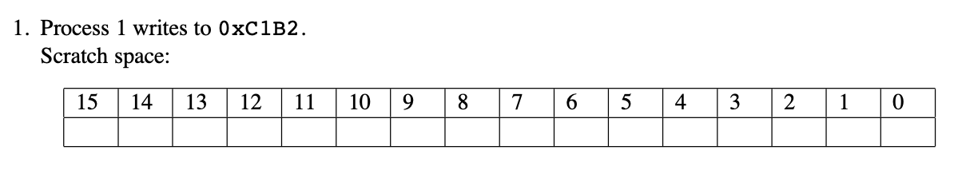
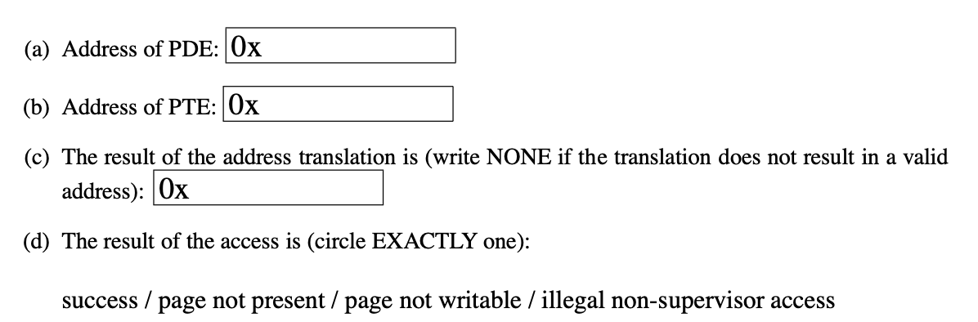
问题4

Slide 11
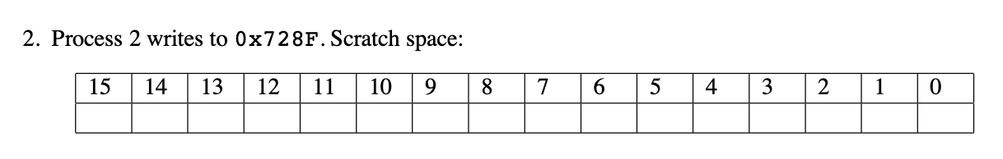
问题4

